Slide 1
Recommendation Systems with R
Laura Da Silva (@LauraDataSci)
&
Darshna Shah (@Darsh262)

Slide 2



What is a recommendation system?
A recommender system is a simple algorithm that aims to present users with suggestions of the most relevant items/products, based on identifying and learning consumers data patterns and choices.
Examples: products you might like, films/tv series you might enjoy, friends you might know

Slide 3
What do recommendation systems aim to do?
1). To predict the rating for an item or product, the user has not yet rated
2).To create the list of the top N recommended items

Slide 4
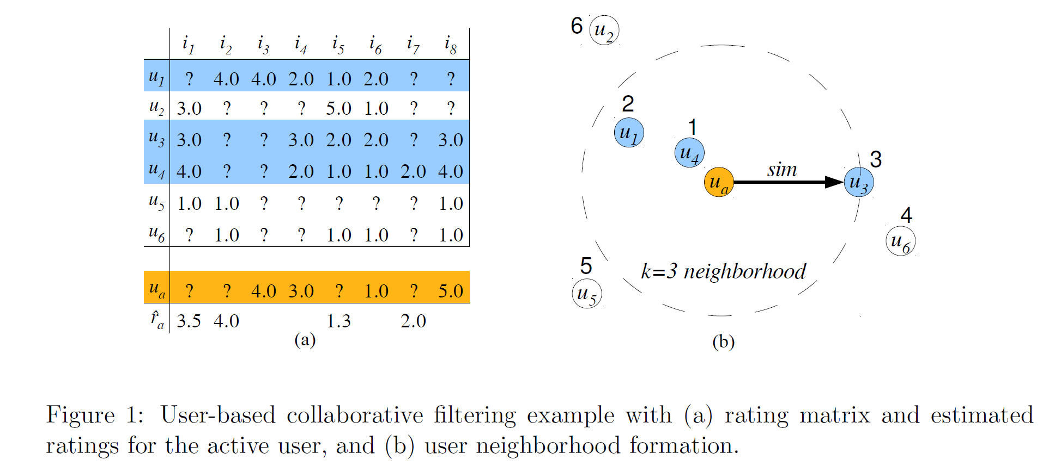
Visual representation of maths behind RS

Slide 5



Types of Recommendation System
Content Based
Collaborative Filtering
Hybrid Approaches

Slide 6
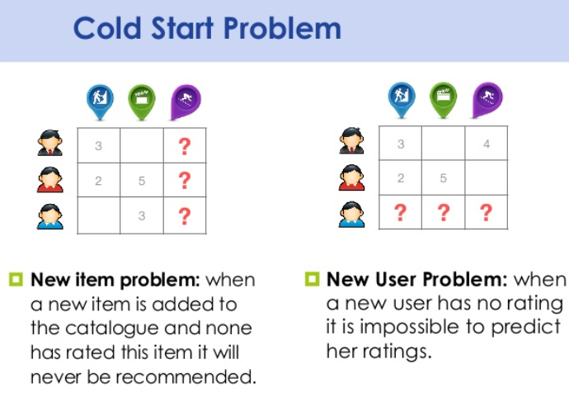
Problems around Recommendation Systems
Cold Start
Overcoming the cold start problem – user profiles.
Validating Recommender Systems
Considerations of user interactions in production environment (e.g. forcing an add vs asking whether a recommendation should be suggested)

Slide 7
Tools and Packages to implement recommender systems
R
Recommenderlab
Python
GraphLab
Crab
SurPRISE

Slide 8
Implementing a Recommender System
DEMO!

Slide 9
Some useful links
https://cran.r-project.org/web/packages/recommenderlab/vignettes/recommenderlab.pdf
http://bigdata-doctor.com/recommender-systems-101-practical-example-in-r/
https://www.analyticsvidhya.com/blog/2015/10/recommendation-engines/
https://www.analyticsvidhya.com/blog/2016/06/quick-guide-build-recommendation-engine-python/

